Slide 1
Version Control

Slide 2
What is version control?
Local Computer
Version control is the process of recording changes to files.
A Version Control System (VCS) allows you to manage file history, so you can:
Roll back to previous states of a file if something goes wrong
Maintain a log of changes
Compare versioning issues
Checkout
Version Database
file
version 3
version 2
version 1

Slide 3
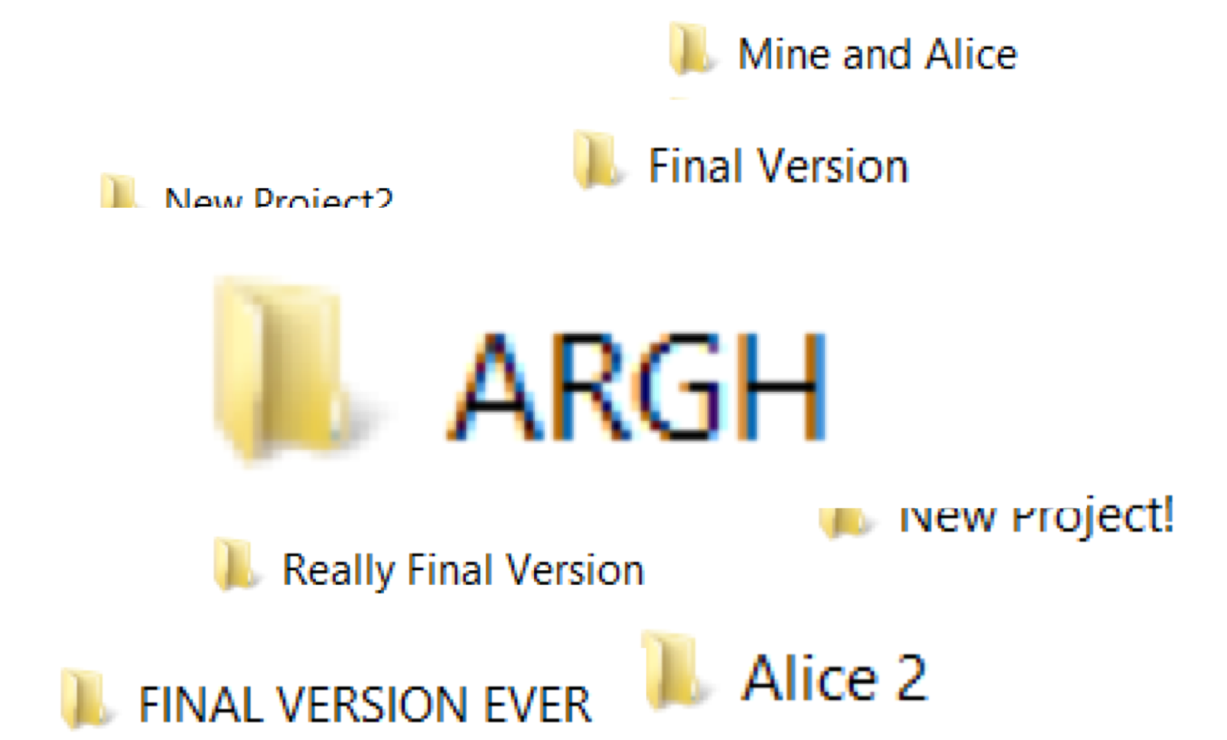
Benefits of version control
Keep track of code and changes
Automated version management
One copy of the code everyone can access
No more mailing around code or confusion trying to integrate it
Multiple people can edit a single project at the same time
Push changes to the central repository
Merge together changes in files where there are conflicts
Branch code to work on specific parts
Version 2.3 doesn’t need to die because someone else wants to look at version 3

Slide 4
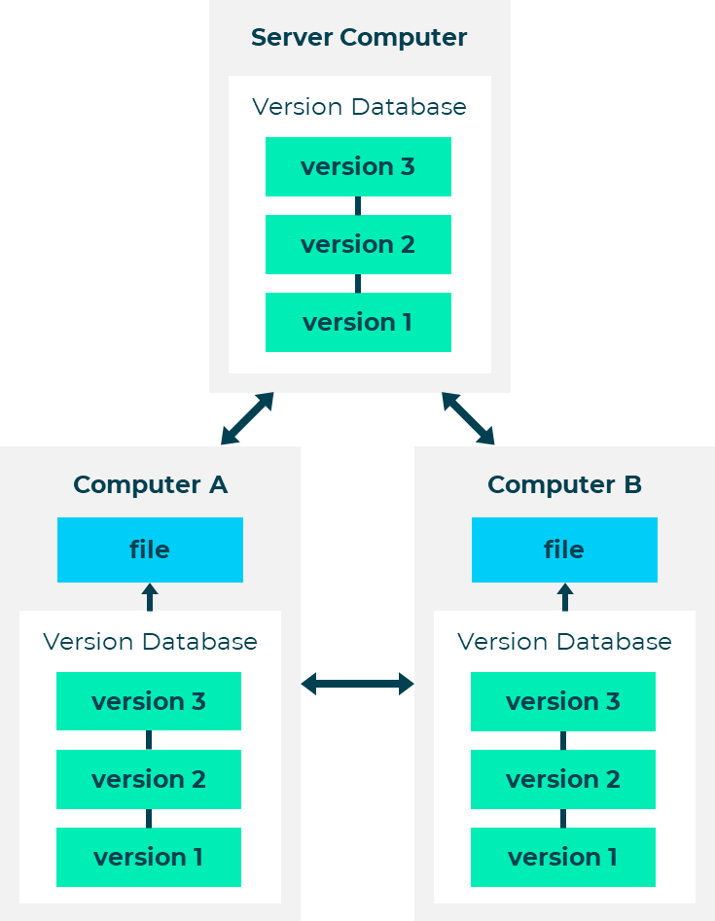
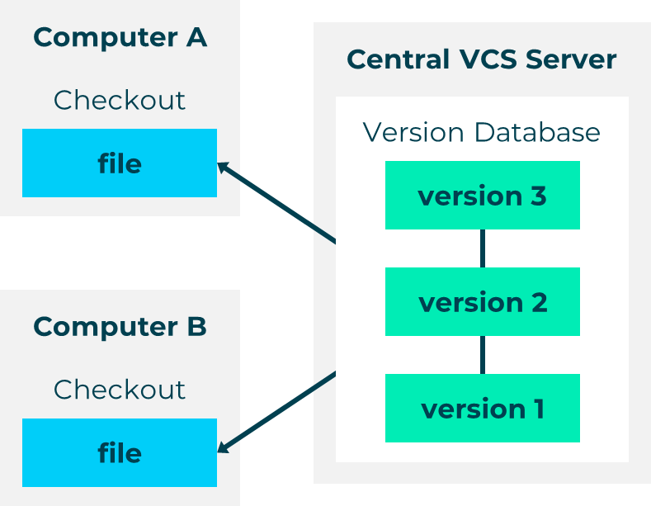
Types of Version Control Systems
Centralised Version Control System (CVCS)
Distributed Version Control System (DVCS)
Notes:
Centralised Version Control System (CVCS)
Allows multiple developers to collaborate on other systems
Single server that contains all version controlled files
Distributed Version Control System (DVCS)
Mirrors the repository
Each checkout is like a backup of the repository.
Branching and merging can happen automatically and quickly.
Developers can work offline.
Multiple copies of resources means there is no need to have a single backup.

Slide 5
GIT as a DVCS

Slide 6
GIT as a DVCS
Git is a powerful version control tool. Its origins are from Linux development, so it’s open source.
Its goals are:
Speed
Simplicity
Strong support for non-linear development
Full distribution
Ability to handle large projects efficiently, e.g. Linux kernel

Slide 7

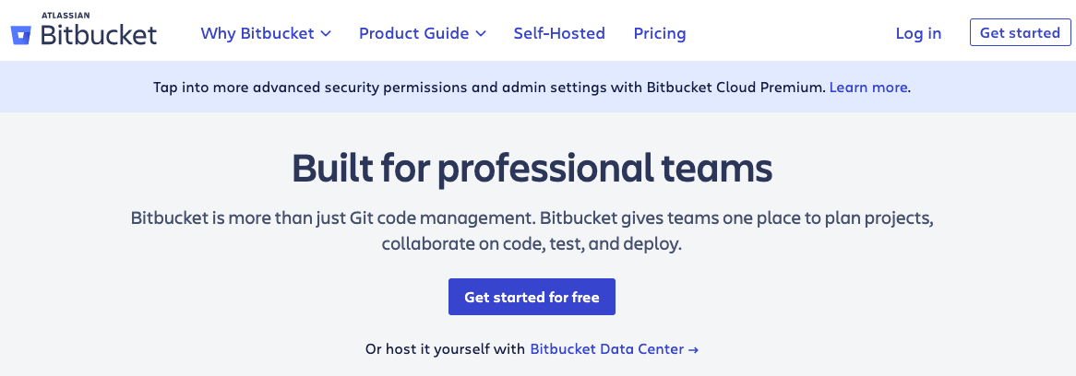
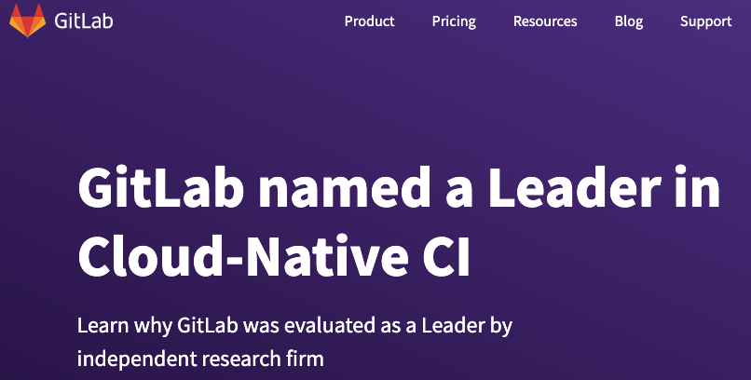
Choosing a hosting service for Git
GitHub
BitBucket
GitLab
Notes:
Bitbucket from Atlassian (2006) are not as popular as GitHub

Slide 8
To make changes to a Git repository, follow these steps:
Create a repository on a hosting site, or your own server
Check out the repository to your own machine using remote add
Add some code
Commit your changes to the local repository
Push changes to the remote repository using git push
USING a hosting service for Git

Slide 9
Git Basics

Slide 10
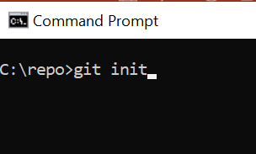
Initialising repositories
To create a new subdirectory and a Git repository skeleton, use:

Slide 11
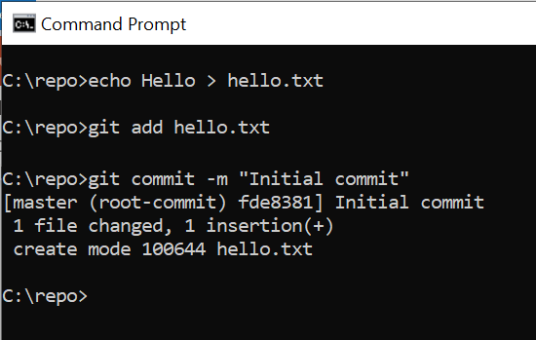
git add *.pp
git add README.md
git commit -m "Initial commit"
Initialising a repository with existing files

Slide 12
Cloning an existing repository
Git can use a number of different protocols, including http and SSH:
git clone git://github.com/resource
Notes:
Get your Github SSH URL:
Choose SSH and enter the SSH URL for your Github repository: ...
Browse to choose your SSH private key:

Slide 13
Each file in a Git directory can be tracked or untracked.
Tracked files are files that were in the last snapshot. They can be unmodified, modified, or staged. Tracked files are also files that Git knows about.
Untracked files are everything else. They’re not in your last snapshot or staging area.
Recording Changes to a Repository
Untracked
Unmodified
Modified
Staged
Add the file
Edit the file
Stage the file
Remove the file
Commit
Notes:
https://git-scm.com/book/en/v2/Git-Basics-Recording-Changes-to-the-Repository

Slide 14
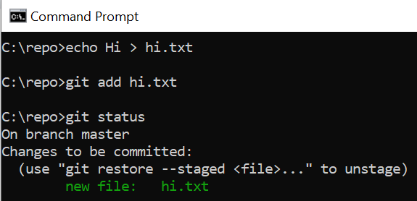
The main tool you use to determine which files are in which state is the git status command. If you run this command directly after a clone, you should see something like this:
Recording Changes to a Repository, cont.
git status
On branch master
Nothing to commit, working directory clean
Notes:
https://git-scm.com/book/en/v2/Git-Basics-Recording-Changes-to-the-Repository

Slide 15
Staging new or ‘modified’ files
To add a file, use:
To tell Git to ignore files or folders, name them: .gitignore
git add <filename>
*.exe
*.dll
*.lib
.bin

Slide 16
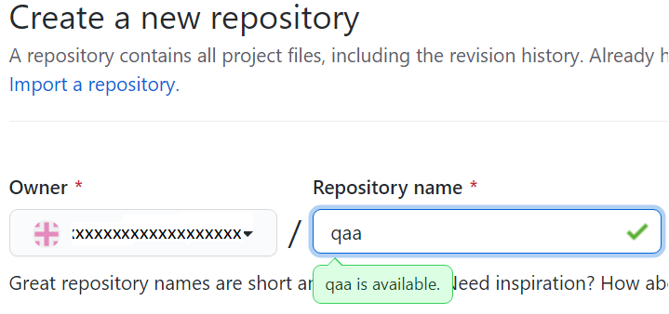
Working with Remote Repositories
Remote repositories hold versions of a project or dependencies on the web / network such as GitHub.

Slide 17
To see configured remote repositories, run the following command:
git remote
If you have cloned a repository you should see the origin.
To add a repository, use:
‘Shortname’ becomes an alias for access to the repository.
Working with Remote Repositories
git remote add [shortname][url]
git remote add origin https://github.com/xxxxxxxxxxxx/qaa.git

Slide 18
Pushing to a repository
To push your project upstream, use:
-v shows you the URL that Git has stored for the shortname
git push origin master
C:\repo>git remote -v
qa https://github.com/xxxxxxxxx/qaa.git (fetch)
To rename a reference: git remote rename
e.g. git remote rename origin qa
git push qa master
Notes:
git push origin master will push changes from the local master branch to the remote master branch.
git push origin will submit all changes from all local branches to matching branches the origin remote.

Slide 19
Pushing to a repository, cont.
To remove a reference, use git remote rm:
git remote rm qa git remote origin
C:\repo>git remote rm qa
C:\repo>git remote -v
C:\repo>git remote add qaa https://github.com/xxxxxx/qaa.git
C:\repo>git remote -v
qaa https://github.com/ xxxxxx /qaa.git (fetch)
qaa https://github.com/ xxxxxx /qaa.git (push)

Slide 20
Pulling from a repository
To pull all the changes made to the repository, use:
Pull the repository before pushing changes
You get an up-to-date copy of the repo to push to
You can see any conflicts before they are pushed
You can stash your changes before pulling the remote branch
git pull
C:\repo>git pull qaa master
From https://github.com/xxxxxx/qaa
* branch master -> FETCH_HEAD
Already up to date.
Notes:
git stash temporarily shelves (or stashes) changes you've made to your working copy so you can work on something else, and then come back and re-apply them later on.

Slide 21
Creating a new branch
To create a branch, use:
To commit any changes to your code, use:
To merge a branch back into the main line, use:
git checkout -b newBranchName
git commit -am "updated some file(s)"
git checkout master
git merge newBranchName
Notes:
Branching allows you to diverge from the main line of development without doing accidental damage to the main line.

Slide 22
Creating a new branch alternative
Rather than use the checkout command shown above, you could use the following two commands:
git branch newBranchName
git checkout newBranchName

Slide 23
Alternatives to git
Git is popular for the following reasons:
Its open source nature
Simplicity
Context switching between branches is easier
Local staging area for commits
GUI tools available such as Sourcetree
Built-in tools in eclipse
…but it isn’t the only option. Alternatives include:
Subversion
CVS
Mercurial
Fossil
Veracity
SSH
Notes:
Subversion
Similar to Git, but CVCS
Add new files, commit to the repository
Pull files from the repository
Tortoise / Rabbit SVN give built in windows context menu options
SSH File Transfer Protocol
Suite of three utilities - slogin, ssh, and scp
File access, file transfer, and file management functionalities
UNIX-based command interface and protocol
Used for securely getting access to a remote computer
SSH commands are encrypted and secure
Authenticated using a digital certificate
Passwords are protected by being encrypted
RSA public key cryptography for both connection and authentication

Slide 24
LAB
‘Experiment with GIT’

